Slide 1
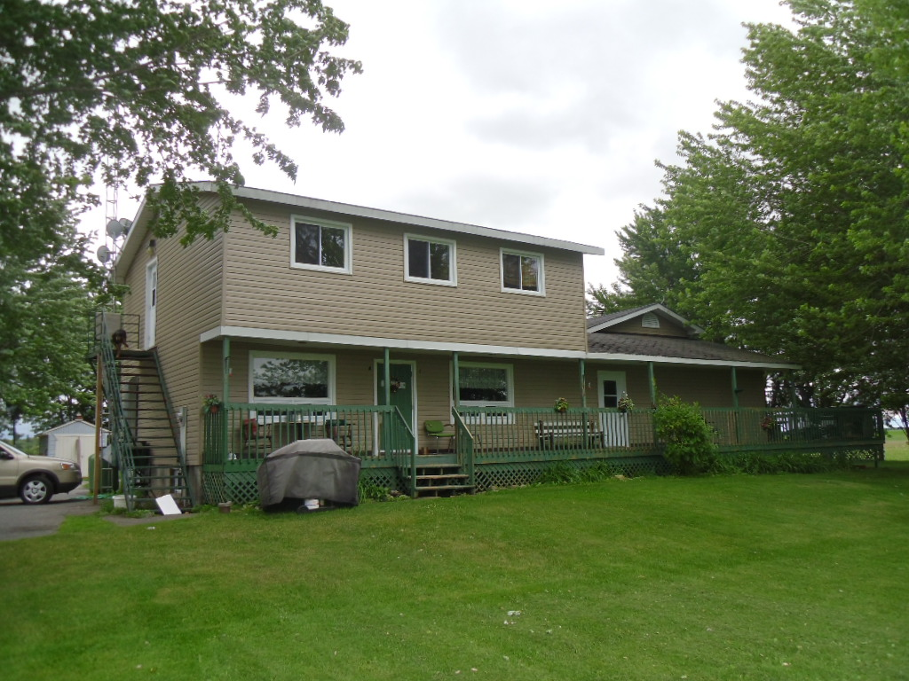
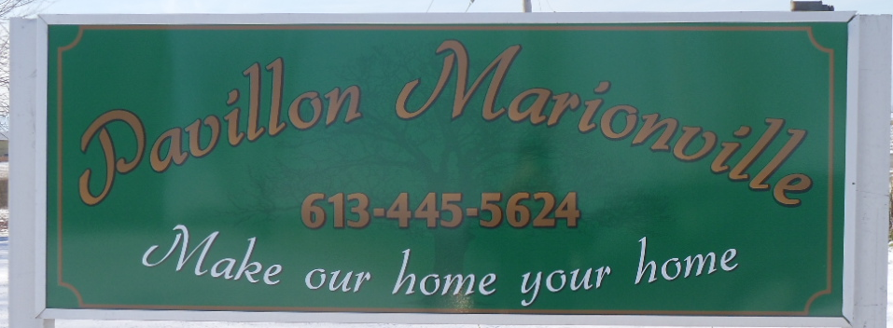

Slide 2
A calm and peaceful home located 20 minutes away from the city in a beautiful country setting.
We are operating within the domiciliary hostel program
which includes assistance with personal needs

Slide 3
New Gazebo providing protection from weather conditions
Large exterior front and rear yards and gardens

Slide 4
Dinning room

Slide 5
Clean and organized kitchen providing healthy and home cooked meals

Slide 6
Living room

Slide 7
Sitting room

Slide 8
Movie area

Slide 9
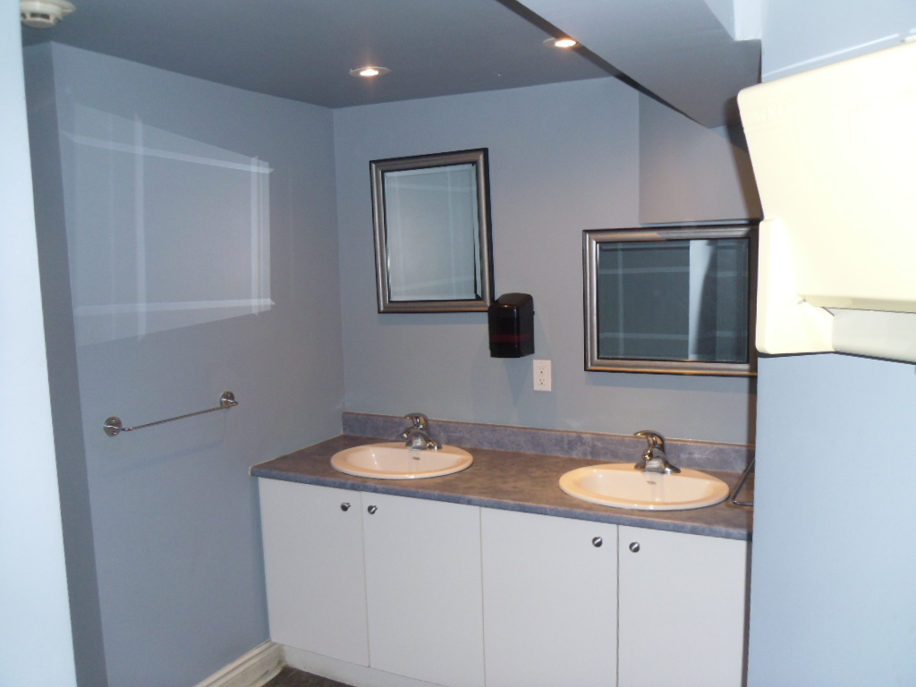
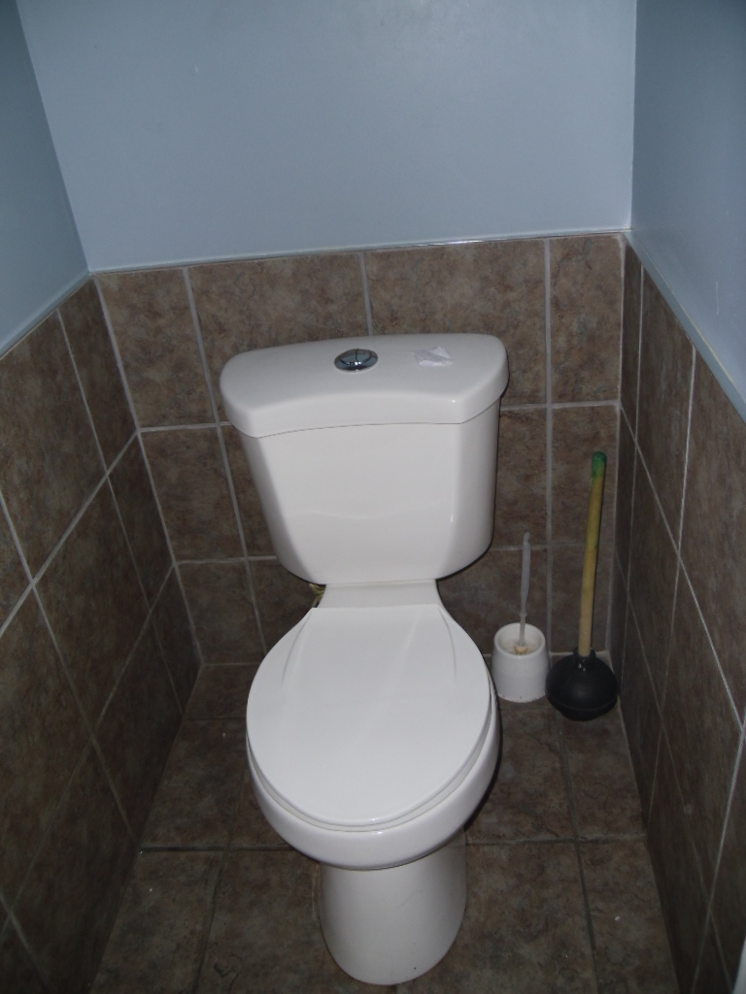
Handicap bathroom
Personal hygiene area
Privacy toilets

Slide 10
Clean spacious single and double rooms

Slide 11
Entertainment area

Slide 12
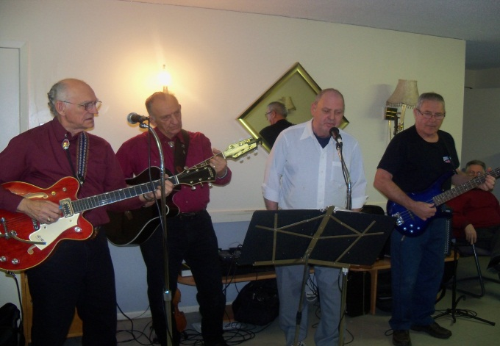
Pavillon Marionville
Make our home your home
-Our goal is to provide a clean, safe and peaceful environment
to all residents. We provide 24 hour bilingual caring staff.
-Various leisure and recreation activities
-Access to doctor service and supervised medication distribution
-Regular housekeeping and laundry services
-Additional services provided on site

