Slide 1


iAccess Tech:
Empowering Inclusive Futures
Master Your Mobile Devices: Organize, Simplify and Thrive
Swipe, Tap, Done!
Tuesday June 24, 2025
12pm

Slide 2

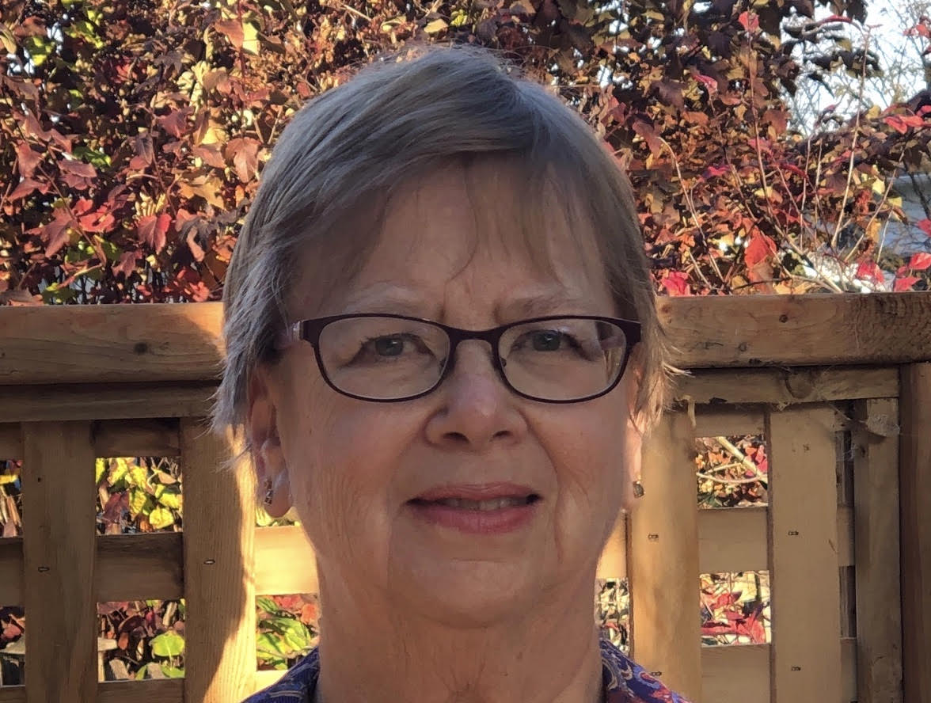
Who am I?
My name is Lynda Muckleston
I’m an instructional designer with iSisters with a focus on accessibility
I’m passionate about using technology to help me successfully manage my day.
I have a brain injury so rely on some of the features we are going to discuss today.
My two adult children have been a resource for some of the information I am sharing with you.
My other passions are gardening, yoga and swimming.

Slide 3
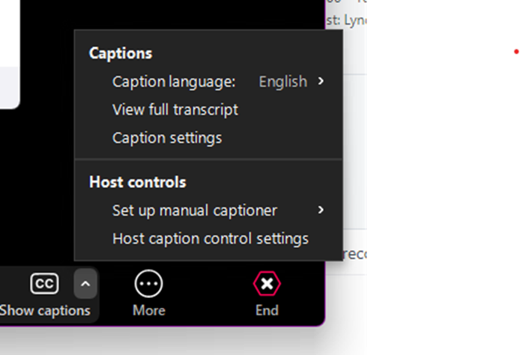
Navigating Zoom
Zoom tool bar – where you find Live Captions and language
Where to find languages
Where to find reactions

Slide 4

Land Acknowledgment
Here at iSisters, we respectfully acknowledge that we work and live on the unceded and unsurrendered territory of the Algonquin Anishinaabe Nation. We commit ourselves to learn the truth and be active in the process of reconciliation.
Ondaje iSisters, nidapiitenindaamin kikenindamang eji ondaamitaayaang ashidj abiyaang ondaje ega wiikaad kamiigiwaaniwang iyo kichi Anishinaabewakii. Niwaawiindamaagemin niinawind kidji-kikenindamang tebwewin ashidj kidji-kwayakijichigeyaang kabii-ijiwebag.
Turtle Island By Patrick Hunter-Indigenous artist

Slide 5

Introduction
What are we talking about today?
We are so used to using our mobile devices to check our email, texts and of course talk to our friends and family, we forget to check out some of the more useful apps that can help us move through the day with less stress.
So, lets learn how we can “Swipe, Tap and Done”, our way through the day.

Slide 6
Transportation
      Transit- Provides real-time data for public transportation (OC Transpo)
      Live Traffic (Ottawa)-real-time road conditions, traffic updates, and map information
      Cabs/Uber-Uber, Ottawa Taxi App, Blue Line Taxi, Capital Taxi or Taxitab

Slide 7

Weather
  Weather Pro
  Environment Canada
  The Weather Network

Slide 8

Shopping
Groceries/Coupons-Checkout 51, all major grocery store apps
General-major stores,
Amazon, Wayfair

Slide 9

Menu Planning/Recipe Organizing
Meal Planning-Don’t forget to use AI for helpful menu planning
Organizing- All recipes or COOKmate

Slide 10
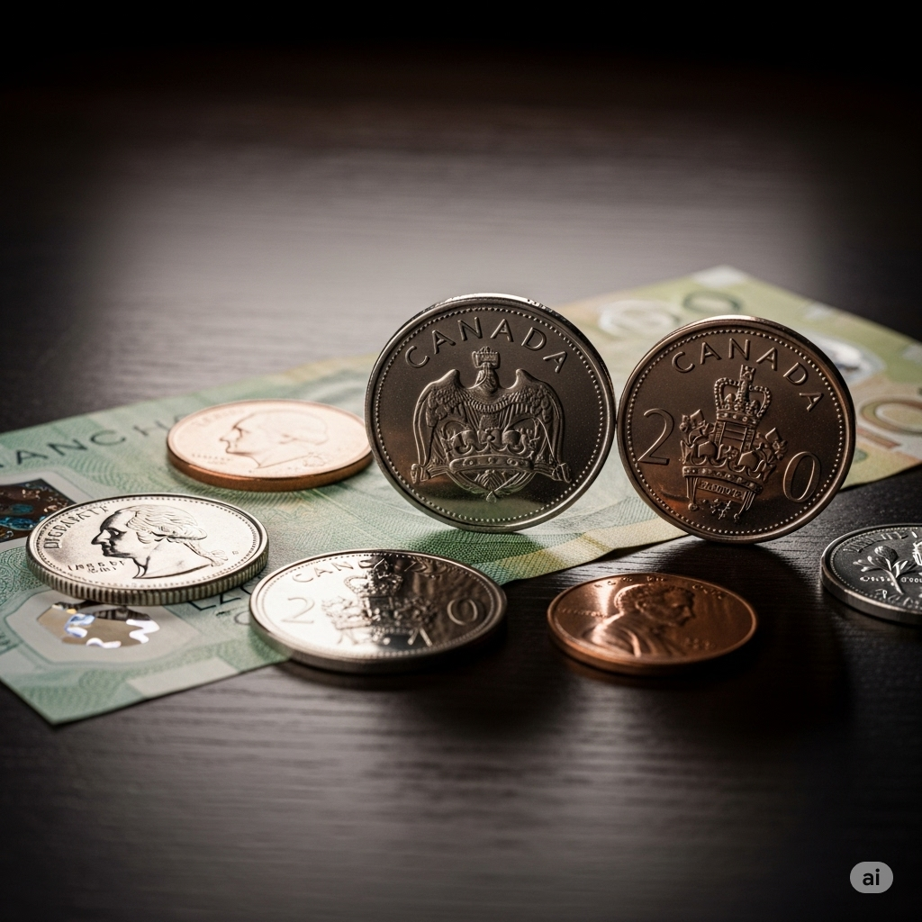
Financial
Banking-major banks
Digital Wallet-having cards handy on your device

Slide 11
Language/Translation
DeepL-real-time voice, text and camera translation as well as pronunciation guides
Google, Microsoft, Apple- all have translation apps, depending on your device

Slide 12

Communication
These are the apps we are most familiar with:
Email
Texting
Talking
Video meetings

Slide 13
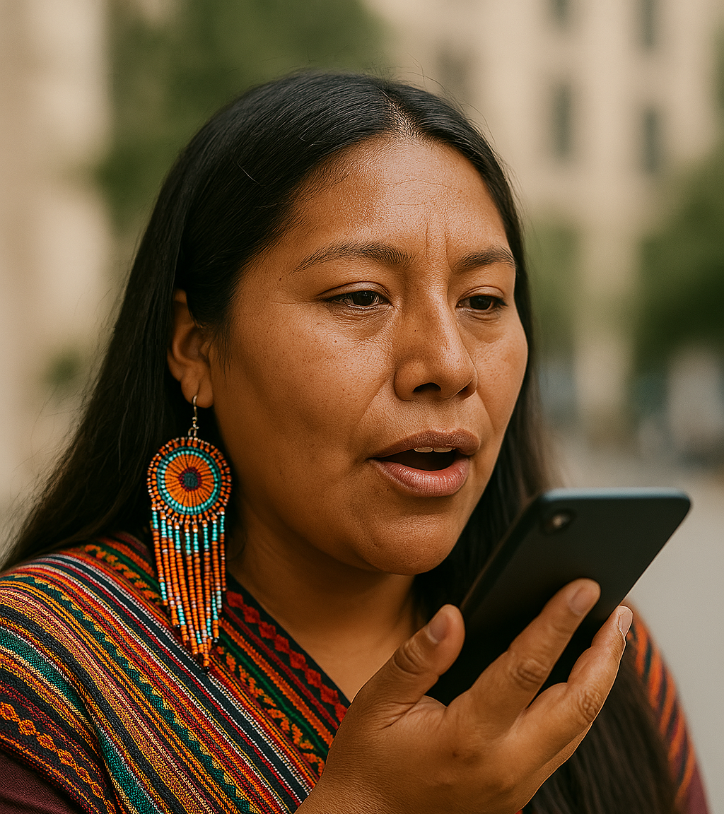
Notes on the Go!
    Voice Memo
    Siri/Alexa/Google

Slide 14
Entertainment
Reading
TV/Movies

Slide 15








What We Learned About Today
Transportation Financial
Weather Language/Translation
Shopping Communications
Menu planning Entertainment

Slide 16
Looking To The Future!
Our next iAccess Tech topic is “Organization and Time Management with Google Tools”.
  We would love to hear any suggestions you might have for future workshops, so please before you leave fill in the poll.

Slide 17
Questions and Contact
Lynda Muckleston
instrdes2@isisters.org

Slide 18

Thank You!
Thank you all for your interest in our workshops and for attending.
We extend our special thanks to Ciena for their generous funding and support of this program.

Slide 19
Additional Resources
The Creation Story-Turtle Island

